Slide 1
Predicting Unproductive Home Call Doctors
Felipe Fagundes
General Assembly – Final Project
Notes:
unproductive

Slide 2
Overview
I work in a Home Care Company in Brazil.
We operate in Brazil for over 2 year. Since them we collected data regarding all the appointments made in patients houses.
Whenever the doctor encounter some issue or problem he could not solve or prescribe something, we need to escalate the issue requesting another doctor with more experience or a specialist to go to the patient residence causing to double our expenses We call this Intercurrence.
This project is to predict when intercurrence may occur so we could prevent to send two doctors to the same house

Slide 3
Data
Started with over 170.000 appointment and 21 Features
Created 9 new features data combining data.
First issue, the data was terrible, too messy, missing a lot of values.
Second issue, was almost impossible to predict intercurrences because more than 95% of the appointment didn’t have intercurrence.
After a good cleanup and re-arranging data I was able to created dummies variable for all categorical values and could start working with some models.
Final data: About 1.500 appointment and 94 Features

Slide 4
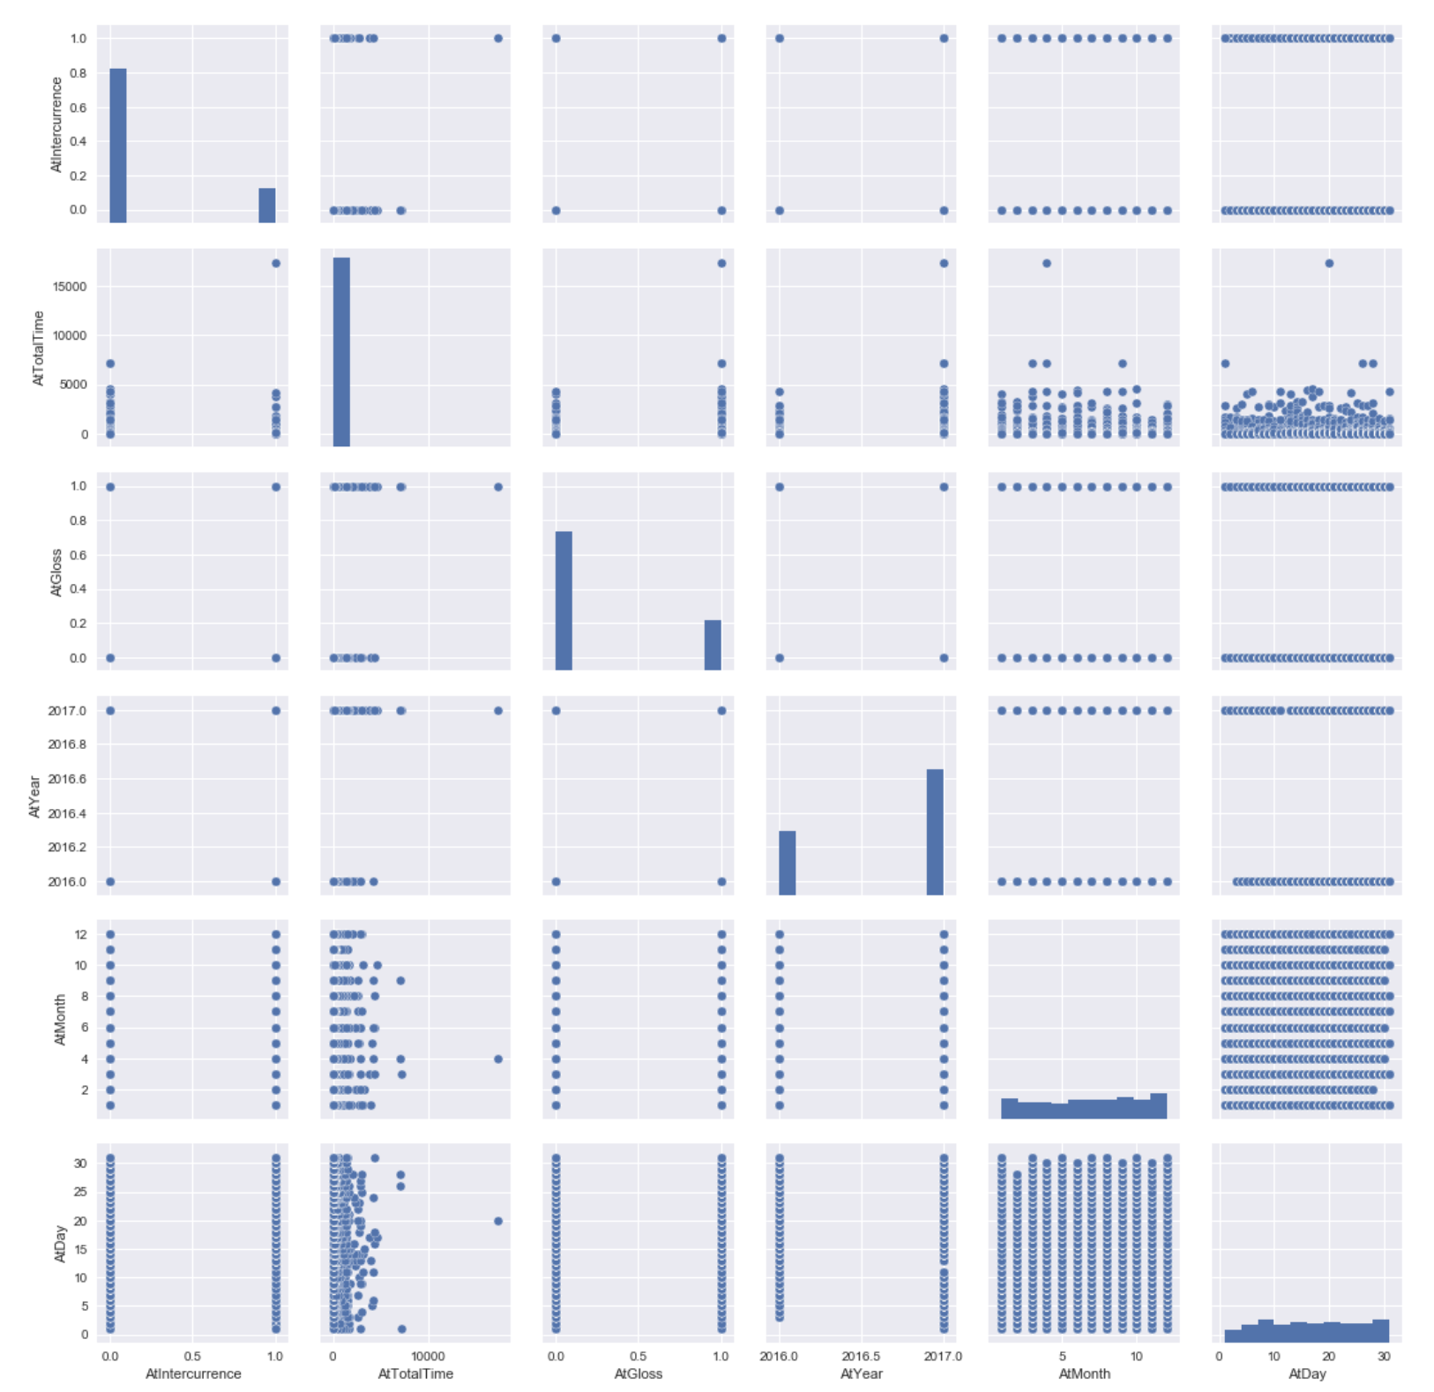
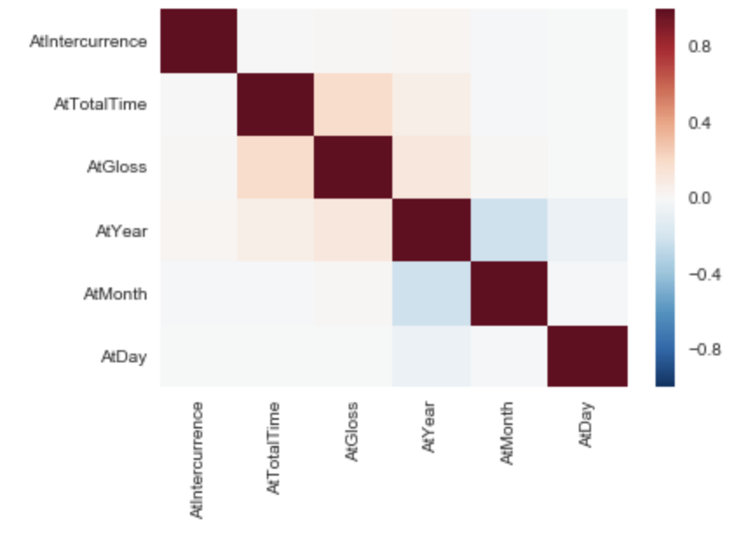
Exploring Data

Slide 5
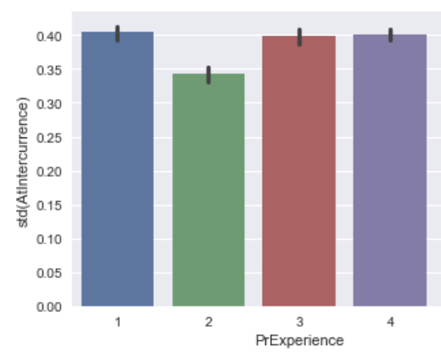
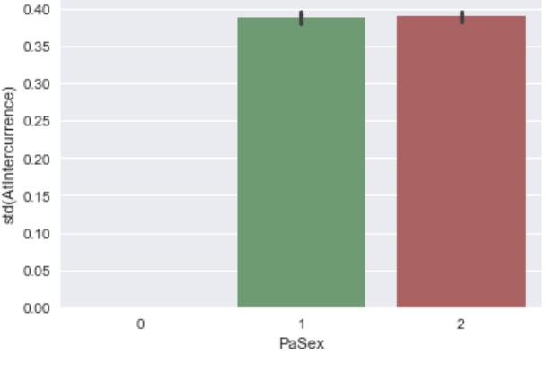
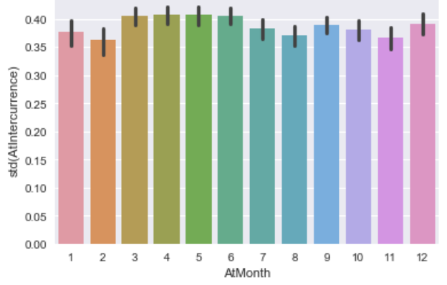
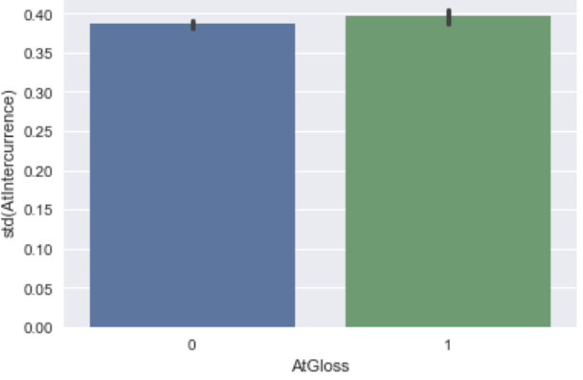
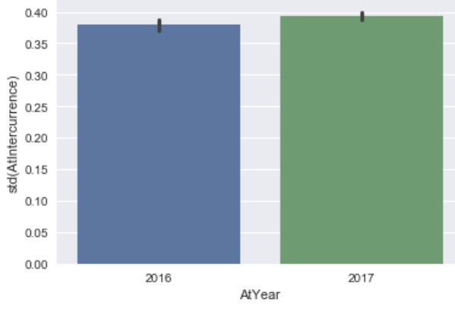
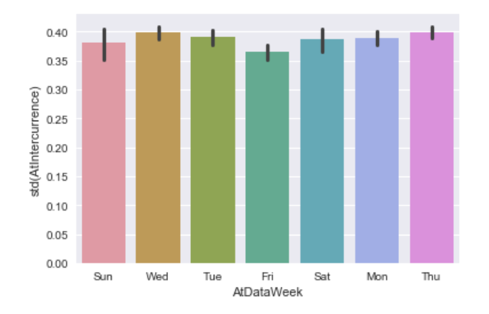
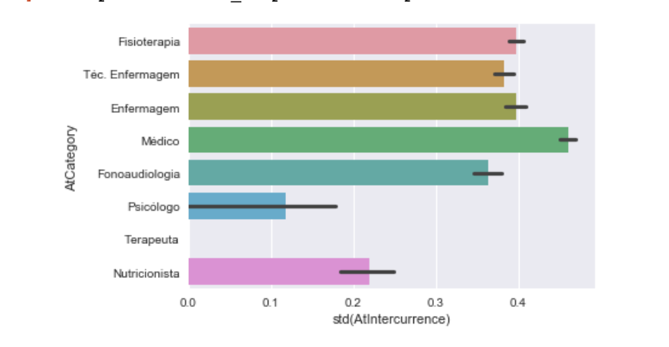
Exploring Data

Slide 6
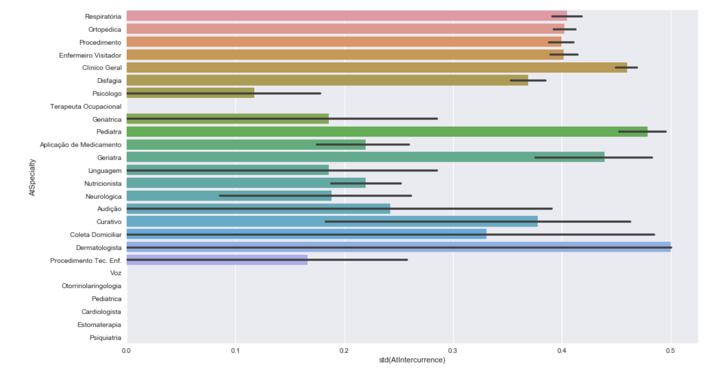
Exploring Data

Slide 7
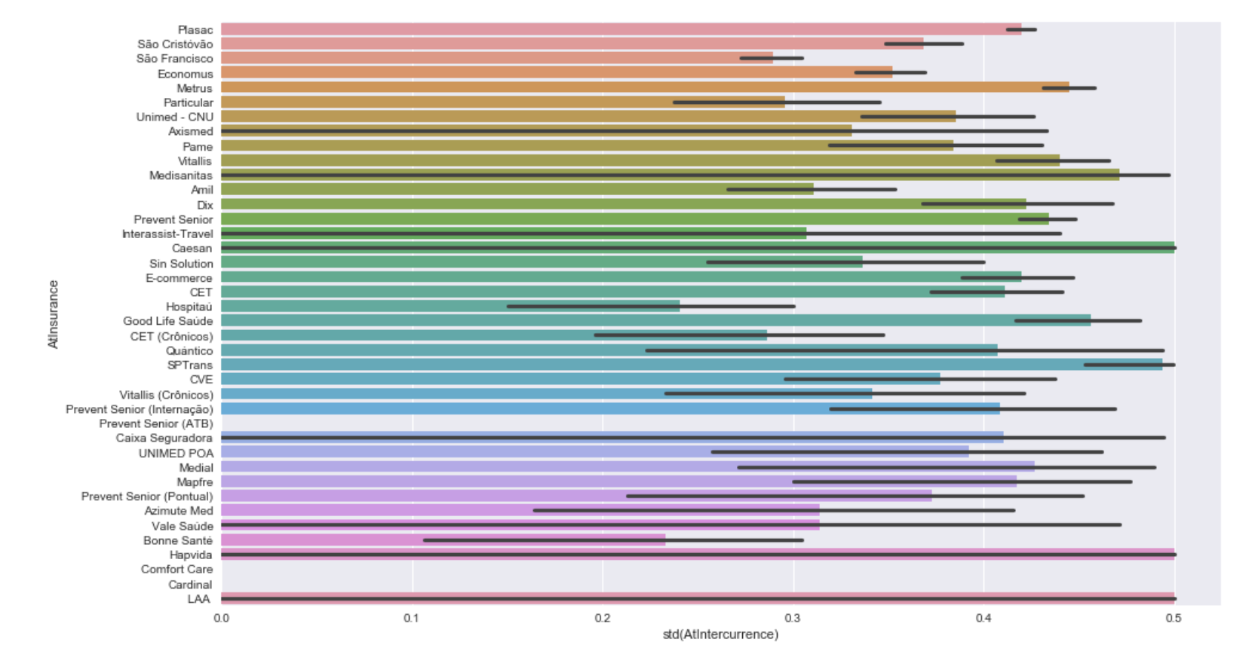
Exploring Data
Exploring Data

Slide 8
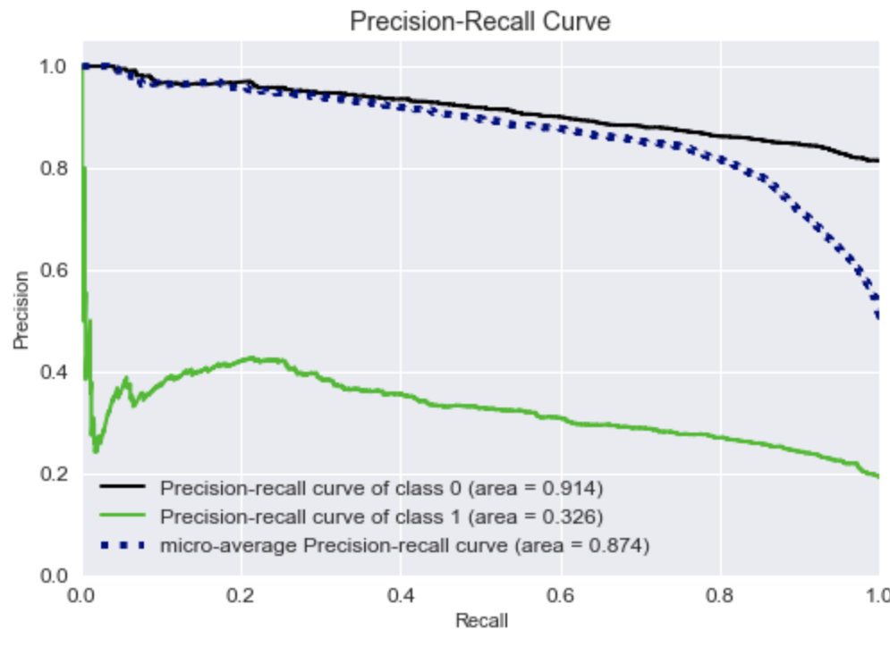
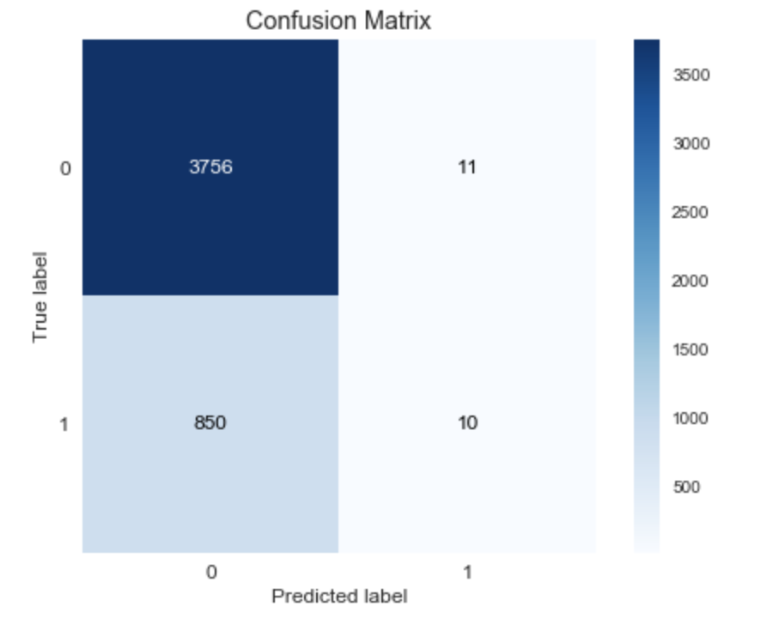
Logistic Regression

Slide 9
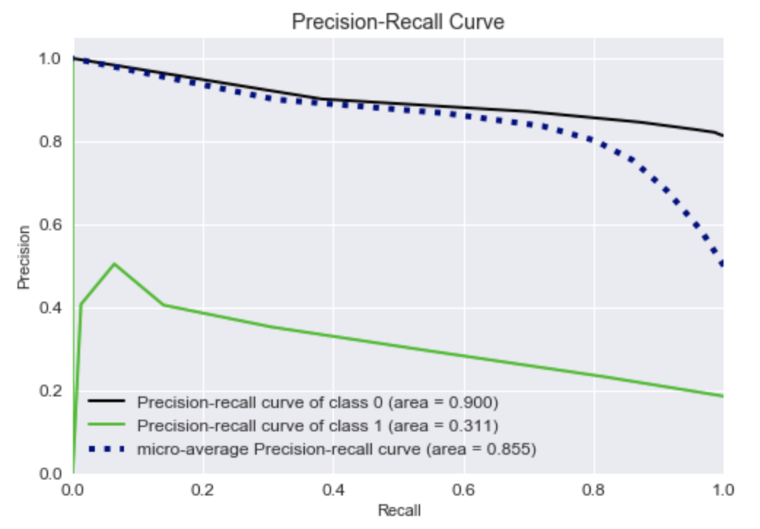
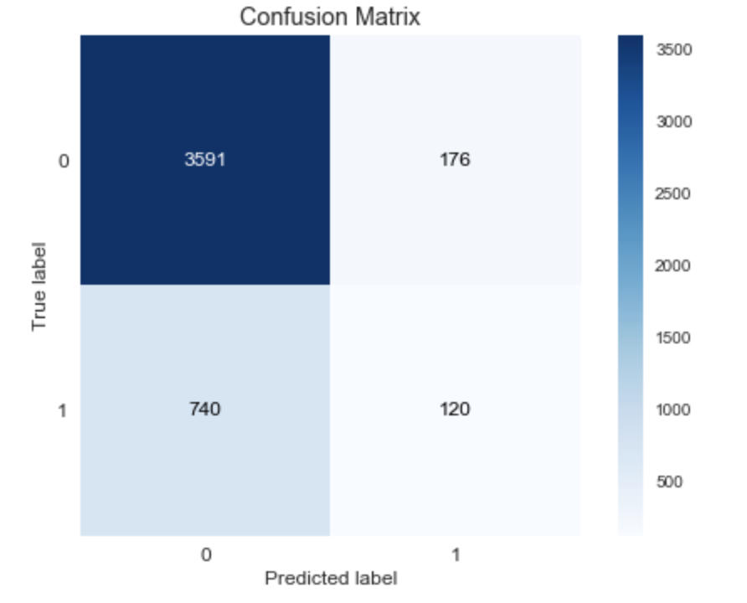
KNN

Slide 10
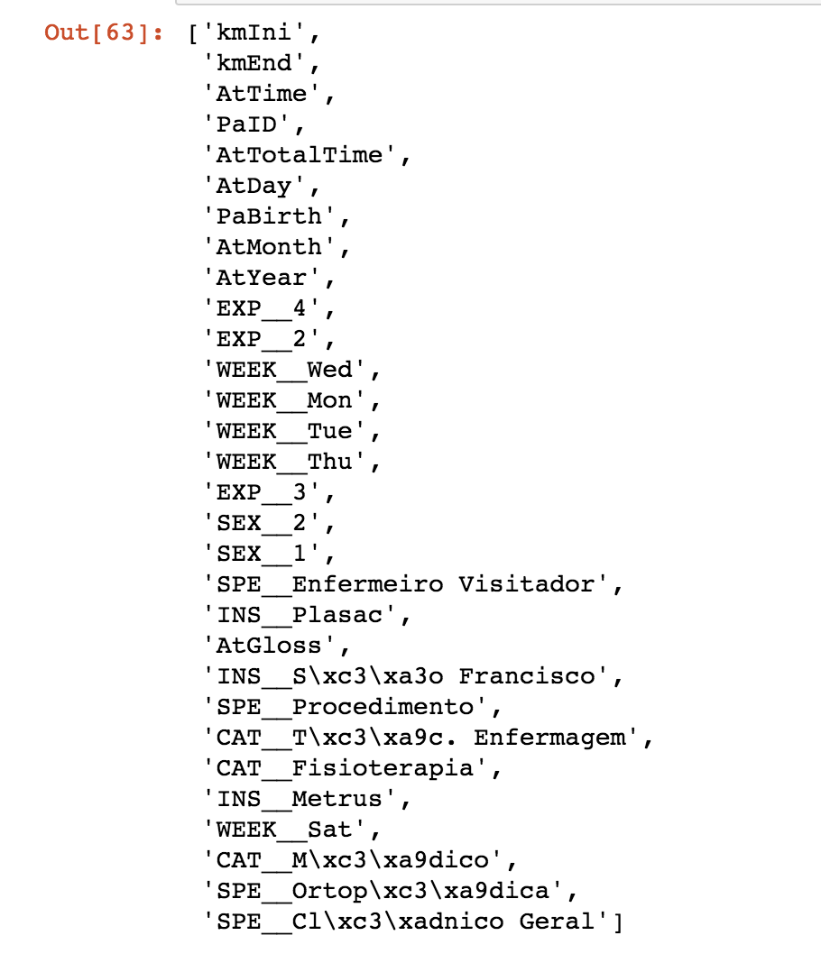
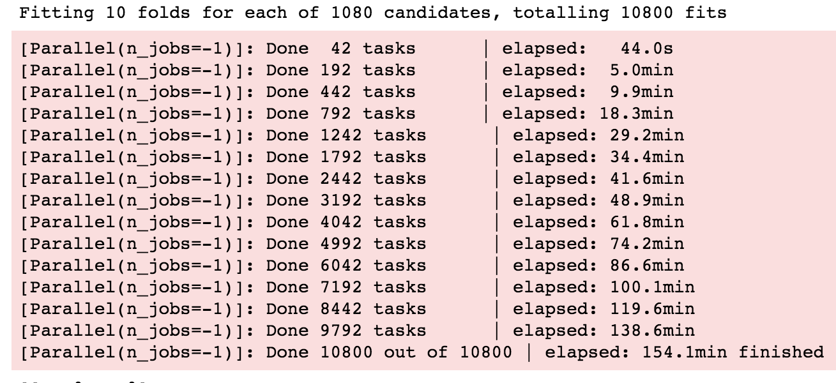
TOP 30 Coefficients
Random Forest
Key hyper-parameter was class_weight

Slide 11
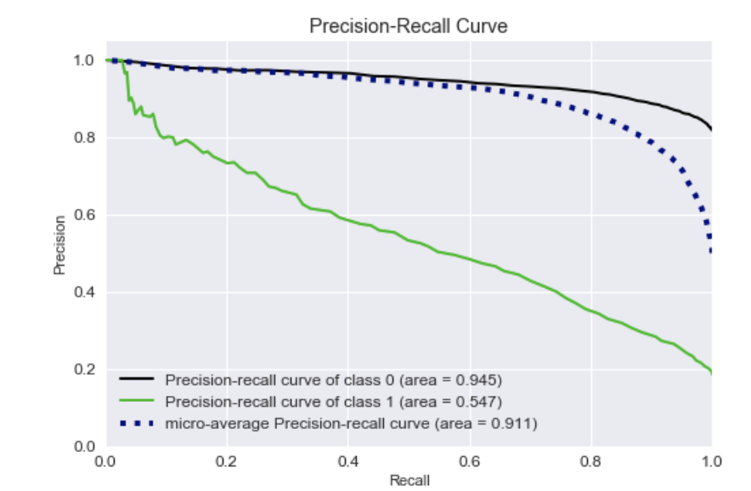
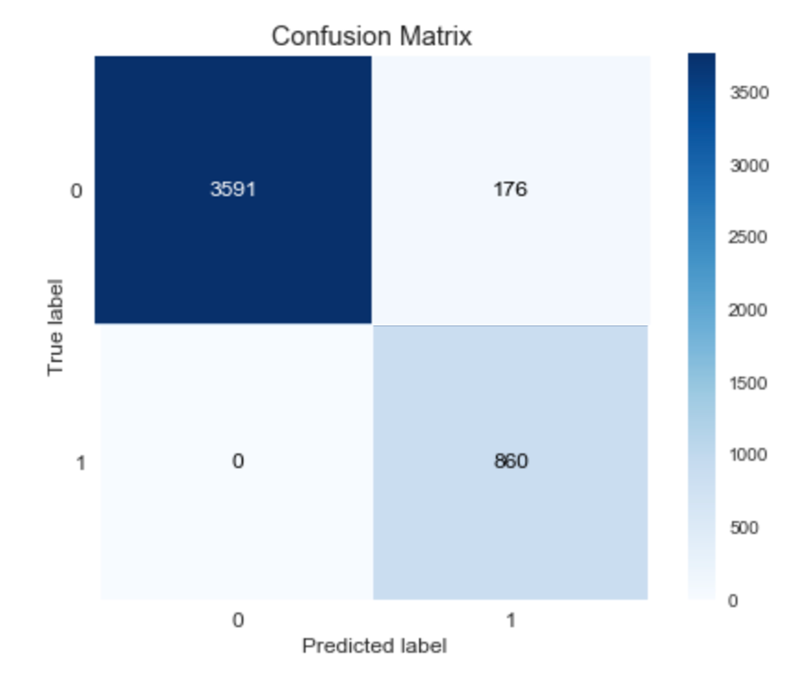
Random Forest

Slide 12
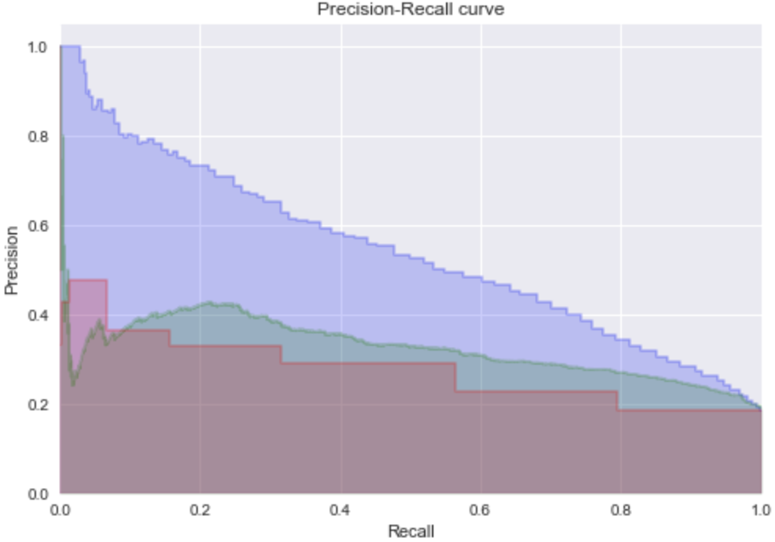
Conclusion
Since my propose is to predict when Intercurrence will happens, I plotted the prediction of the value one (with intercurrence) for all three models.
I could clearly see the blue one (Random Forrest) is so much better than the others and could be improved even further.

Slide 13
Future Work…
Collect more and different data
Improve the model with new data
Improve the current system to collect more accurate data
Since we have couple of open text fields, use text classification
Cross information with hospital and insurance data
Thank you…

